Slide 1

E2E-Novelvista-Systems_C CPP Linux Programming Sep 20th Batch _ Group 1
P. Vigneshwar
D. Sunil Kumar
G.V.V. Priyanka
P. Lakshmi Priya
G. Siva Priya Reddy

Slide 2
SECURE SOCKET IMPLEMENTATION FOR DATA MANAGEMENT
(ONLINE LIBRARY MANAGEMENT SYSTEM)

Slide 3

Introduction:
An eBook (short for electronic book), also known as an e-book
or eBook, is a book publication made available in digital form,
consisting of text, images, or both, readable on the flat-panel
display of computers or other electronic devices.
Although sometimes defined as "an electronic version of a printed
book“.
some e-books exist without a printed equivalent.
E-books can be read on dedicated e-reader devices, but also
on any computer device that features a controllable viewing screen,
including desktop computers, laptops, tablets and smartphones.

Slide 4
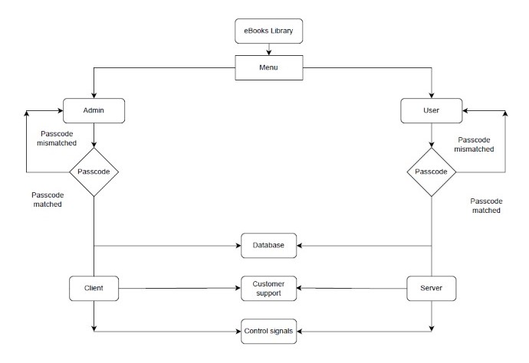
Block diagram:

Slide 5
Admin
Admin can enter into e-lms by validating password.
Admin can have multiple chances to enter valid password if entered password is incorrect for thrice then account will be blocked.
Once admin provides valid password then he enter to next step where he finds options to perform operations on database and customer support as well.
If admin select database then admin will be provided with following options.
1.Insert
2.Retrieve
3.Delete

Slide 6
Admin Choice:
Insert ()- when admin opt for option one then admin is allowed to insert book details including book id, book name and book URL .
Retrieve()-if option two is selected by admin then all the book details that are inserted into database are displayed on the terminal.
Delete()-when admin selects option three then admin is permitted to delete particular book record from database.
In addition to database customer support option is also provided to admin.
If user request for customer support then admin should choose option two in admin menu then, communication is established and are ready to send messages to each other.

Slide 7
User
user menu is provided with four options.
1.login
2.register.
3.forgot username or password
4.customer support
if user is using e-lms first time then he has to register to the portal initially by selecting option one.
Once login is successful then user enables to access books in database by selecting retrieve option then user is able to view books list with corresponding URLs and can download particular book.
Within login page user is provided with customer support so that he can interact with admin for any download related queries.

Slide 8
User Login
If user directly login into platform without registration then user will be notified with message “login failed, please complete registration process". And user menu will be displayed then he has to choose two to register.
If user forgets either password or username then select option three so that user will be provided with further two more options. 1.username recovery. 2.password recovery. If user enter one then he can recover username by providing username. If user enters two then he can recover password by providing password.
If user enter option four then he can interact with admin for any find of support or queries. This customer support is archived by sockets

Slide 9

Database:
Create library using database – Storage of Book URLs
Library contains Book ID, Book name and Book URL
Insert/Delete/Retrieve URLs to download books
digitally
Insert Book details to database
Retrieve Book URLs to download books along with
book name and ID
Delete book information by providing BookID
Enables Admin to access library with valid login credential and user to retrieve information to download digitally

Slide 10
Concepts involved in E-LMS File Handling
File Handling is used to create file to store user login credentials
Append() – Append is used to update file with newly registered user credentials
Search() – To compare the appended credentials with user entered credentials whenever logged in
Read() – To read user credentials and compare with file data for login process
Write() – To store user credentials to file whenever registered

Slide 11
EXECV family
EXECV family replaces the current running process with a new process and ignores remaining part of the program
Argv is a null terminator array of character pointer
Execv is used in customer support to access client by admin and server by user codes to provide communication between user and admin.

Slide 12
Sockets
Allows to exchange information between processes on the same machine or across a network
Socket provides bidirectional FIFO communication facility over the networks.
Each socket has a specific address. This address is composed of an IP address and a port number.
Sockets are generally employed in client server application.
In this demo project sockets are used to establish communication between admin and user.

Slide 13
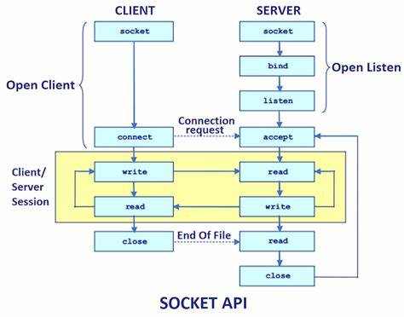
Server-Client model
Server side Function calls
Create() – to create socket.
Bind() – after socket creation bind function will binds the socket to the address and port number specified in addr.
Listen() – it puts the server in passive mode, where it waits for the client to approach server to make a connection.
Accept() – it extracts the first connection request on the queue and returns a new file descriptor referring to that socket. At this point of time client server connection is established, and are ready to transfer data.

Slide 14
Client side Function calls
Create () – it creates socket on client side.
Connect()- the connect system call connects the socket referred to by the file descriptor sockfd to the address specified by addr
Write ()- to send data from client to server and vice versa.
read() – to receive data from either client or server
Close() – to close a connection.

Slide 15
SIGNALS
Signal is a software generated interrupt that is sent to a process by os.
A process can replace the default signal handler for almost all signals by it’s user own handler function.
There are fix set of signals that can be sent to a process. signal are identified by integers.
Signal number have symbolic names.

Slide 16
SIGNALS
In this project if the user enters the wrong menu by mistake, then the CTRL+C signal calls the sigint_handler function and returns to the main menu.
if the user wants to exit from the program , then the CTRL+Z signal calls the sigtstp_handler function and exits from the program.
if the user wants to close the connection or exit from the chat box, they can press CTRL+Z and this signal send a exit command to admin and close the connection and exit from the program and vice versa.

Slide 17
Goals and Objectives
Storing book URLs by creating library using database
To enable Admin to Insert/Retrieve/Delete information over Database in which books details are stored
To enable user to retrieve information from database with proper registration and valis login credentials
Enables customer support using sockets

Slide 18

Our Target
Library to store books in digital format is achieved
Admin access over database is achieved
Easy information retrieval for user with valid login credentials is achieved
Customer support is achieved

Slide 19

Conclusion
Online library management system facilitates user to read books digitally.
It also facilitates admin to manage library books and other data through online.
It also provides live support through customer support option when user encounters problem at any level.

Slide 20



